Slide 1
PaNOSC overview for ORSO
26. May, 2019
Thomas H. Rod, ESS, on behalf of the PaNOSC consortium

Slide 2
Outline
Context for PaNOSC (what is EOSC?)
Objectives of PaNOSC
How PaNOSC and ORSO are related

Slide 3
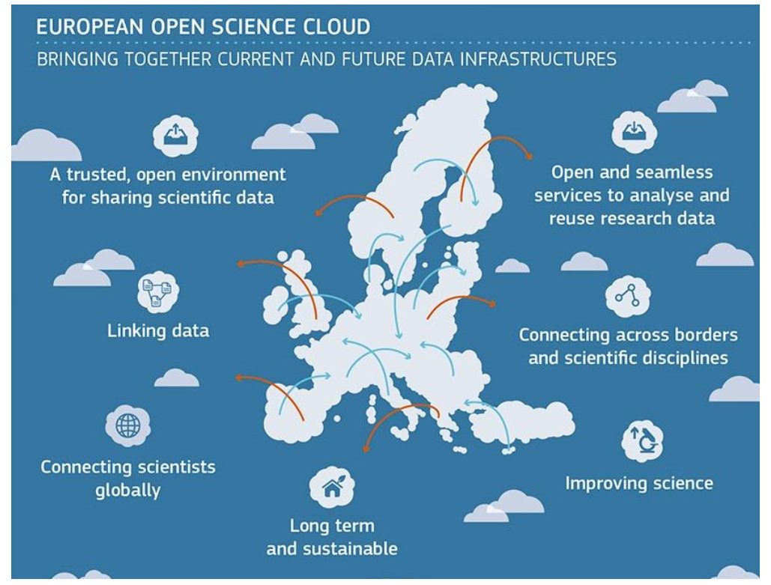
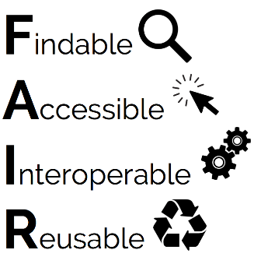
European Open Science Cloud (EOSC)
https://ec.europa.eu/research/openscience/
Promoting open science
EOSC Declaration endorsed 2017 by p&n sources

Slide 4


European Open Science Cloud (EOSC)
https://ec.europa.eu/research/openscience/
Promoting open science
ESFRI cluster projects:
(Currently 47 funded EOSC projects)
Notes:
EOSC-hub: single contact point
ENVRI: Environmental Research Infrastructures
ESCAPE: European Science Cluster of Astronomy and Particle Physics ESFRIs
SSHOC: Social Sciences & Humanities Open Cloud (SSHOC)

Slide 5
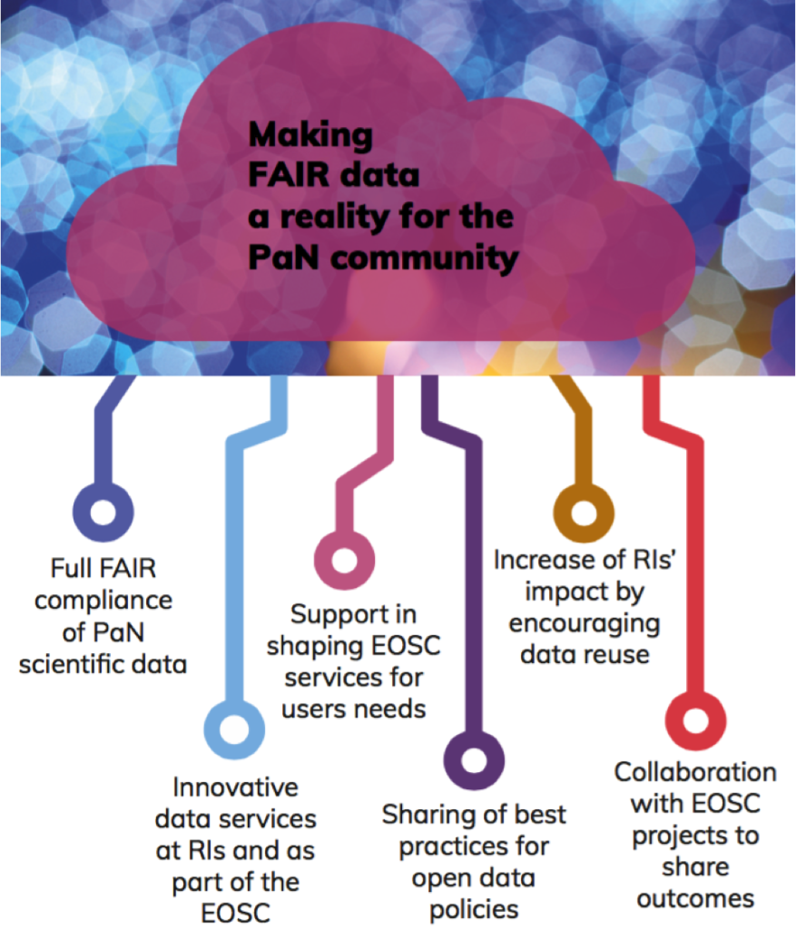








PaNOSC (panosc.eu)
Photon and Neutron Open Science Cloud
Partners are all ESFRI photon and neutron sources + EGI

Slide 6
PaNOSC fact sheet
Photon and Neutron Open Science Cloud
Call: Horizon 2020 InfraEOSC-04
Partners: ESRF, ILL, XFEL.EU, ESS, CERIC-ERIC, ELI-DC, EGI
Description: cluster of ESFRI Photon and Neutron sources
Observers/non-funded: GÉANT, EUDAT, national RIs
Linked 3rd parties via EGI: DESY, STFC, CESNET
Status: Started 1/12/2018
Github: https://github.com/panosc-eu
Home page: https://panosc.eu
Twitter: @PaNOSC_eu #PaNOSC
Budget: 12 M€
Coordinator: ESRF
Duration: 4 years

Slide 7
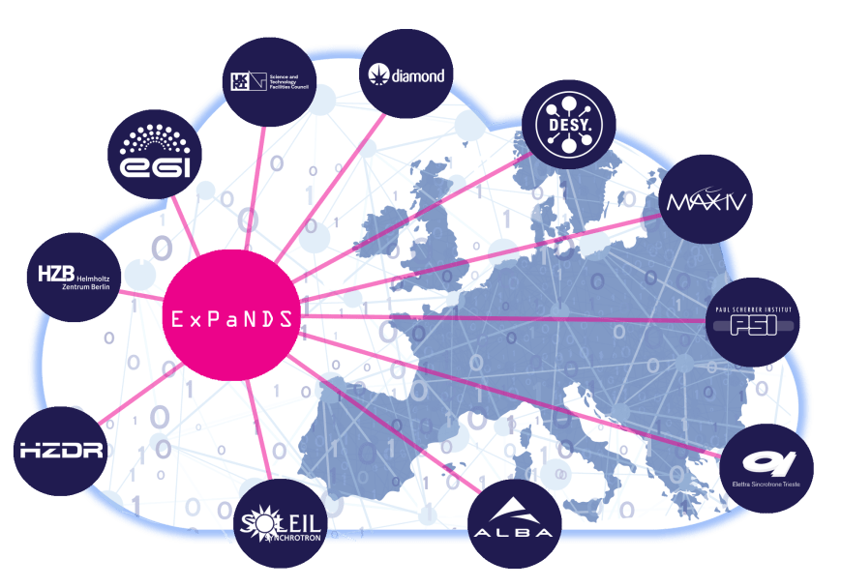
ExPaNDS (expands.eu)
EOSC Photon and Neutron Data Service
Involves almost all European national p&n sources
Collaborates closely with PaNOSC

Slide 8
PaNOSC objectives
Participate in the construction of the EOSC
Make data produced at Europe’s major Photon and Neutron sources FAIR
Harmonize / Generalise open data policies, standard metadata and data stewardship
Provide innovative data services via the EOSC.
Increase the impact of RIs by ensuring data are used beyond the initial scope.
Promote open science in the community.

Slide 9
PaNOSC & ORSO
PaNOSC work packages
WP1: Management
WP2: Data policy and Stewardship
WP3: Data catalog services
WP4: Data Analysis Services
WP5: Virtual Neutron and X-ray Lab
WP6: EOSC integration
WP7: Sustainability
WP8: Staff and user training
WP9: Outreach / Communication and Dissemination / Impact
ORSO Working Gr.
File formats
Data Analysis
Reproducibility
Education and Outreach

Slide 10



More on the technical work packages
#WP & title | Description
WP3: Data catalogue services | Harmonizing NeXus and meta data definitions across p&n sources
WP4: Data analysis services | Cloud services (remote desktop and Jupyter) and traceability and reproducibiity based on Jupyter and Binder (see panosc.eu for example on COVID-19)
WP5: Virtual lab | Harmonize interfaces and link to data treatment
WP8: Staff and user training | Staff and user training in data stewardship and panosc services and maintenance of pan-learning.org
pan-learning.org

Slide 11
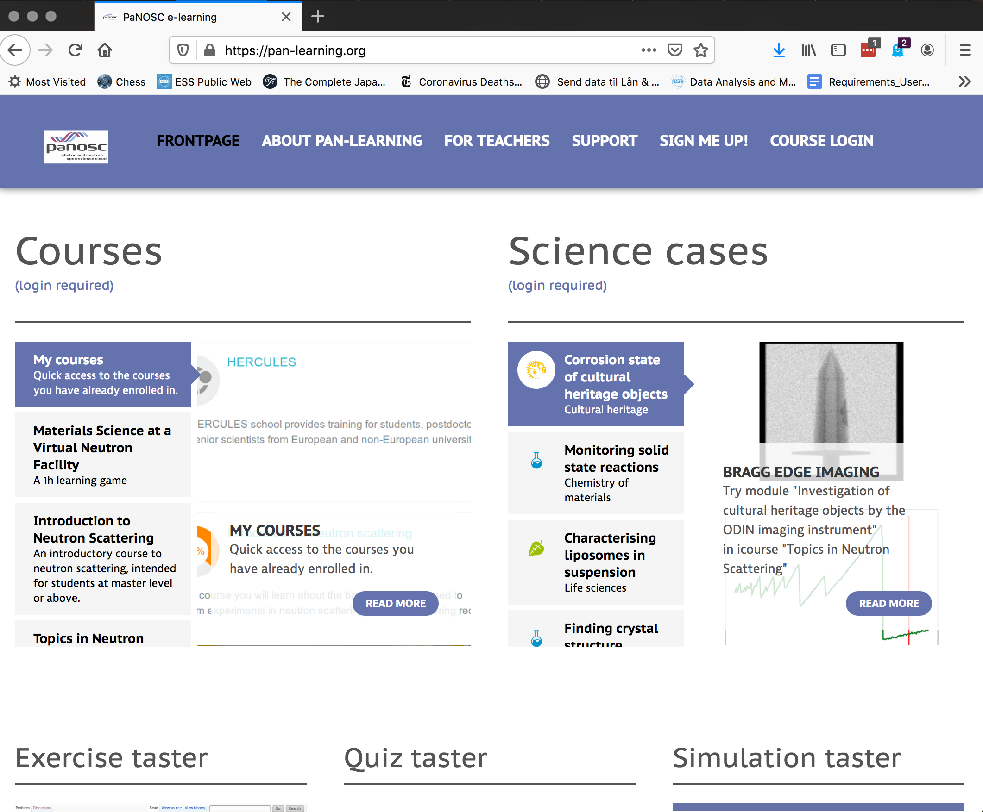

Training (pan-learning.org)
Other:
Training in aspects related to software development, e.g. how to use conda

Slide 12
Thank you
Thomas.Rod@ess.eu

Slide 13

PaNOSC KPIs – 2018/2023
 | ILL | ESRF | CERIC | XFEL | ELI | ESS
Data/year 2018 | 0.2 PB | 8 PB | 1 PB | 3PB | < 1 PB | 0
Data/year 2023 | 0.6 PB | 50 PB | 15 PB | 100 PB | 10 PB | < 1 PB
Data Policy 2018 | 2011 | 2016 | 2014(3/8) | 2017 | in prog | 2017
Data Policy 2023 | 2011 | 2016 | 2019 | 2017 | 2019 | 2017
Metadata catalogue 2018 | Local | Icat | Local | myMdC | No | SciCat
Metadata catalogue 2023 | Local | Icat | Icat | myMdC | [TBD] | SciCat
Metadata definition 2018 | Nexus | Nexus | custom | myMdC | ? | Nexus
Metadata definition 2023 | Nexus | Nexus | Nexus | Nexus | [Nexus] | Nexus
DOI 2018 | yes | yes | no | yes | no | yes
DOI 2023 | yes | yes | yes | yes | yes | yes

Slide 14
PaNOSC KPIs – 2018/2023
 | ILL | ESRF | CERIC | XFEL | ELI | ESS
Open Data 2018 | Yes | Yes | No | Yes | No | No
Open Data 2023 | Yes | Yes | Yes | Yes | Yes | Yes
Data Services 2018 | Pilot | In progress | Remote | In progress | ? | In progress
Data Services 2023 | Prod | Prod | Prod | Prod | Prod | Prod
Common data API 2018 | No | No | No | No | No | No
Common data API 2023 | Yes | Yes | Yes | Yes | Yes | Yes
User training 2018 | No | No | No | No | No | No
User training 2023 | Yes | Yes | Yes | Yes | Yes | Yes

